Slide 1

AI Mental Health Therapist
By Abdullah Imran
TherapyX AI
Ver - 2.0

Slide 2
Overview - What TherapyX AI Do?
Therapeutic & Empathetic Conversations
Provides supportive mental-health guidance using reasoning, enabling calm, compassionate responses to user emotions.
Crisis Detection & Emergency Support
Identifies high-risk or distress signals and can trigger a Twilio emergency voice call to a predefined helpline for immediate human assistance.
Locate Nearby Therapists
Uses the Google API to find real, verified mental-health professionals near the user, including name, address, and contact details.
Available Across Multiple Platforms
Streamlit Web Chat Interface
WhatsApp via the Twilio messaging webhook
Supportive Companion (Not a Replacement)
Designed to assist and guide users while reminding them it is not a substitute for licensed medical c

Slide 3











Topics Covered
AI & LLM Stack
Healthcare-focused LLMs (MedGemma – Google)
Multi-model LLMs via Ollama API (GPT-4, Claude, Groq, etc.)
AI Chatbot development using LangGraph & LangChain
Agentic workflow with tool-calling & reasoning
Frontend Interfaces
Streamlit Web Chat UI
WhatsApp Chat Interface via Twilio
Backend & Infrastructure
FastAPI backend (WhatsApp webhook + /ask API)
NGROK tunneling for public WhatsApp access
Clean repository structure (Version 2 optimized)

Slide 4
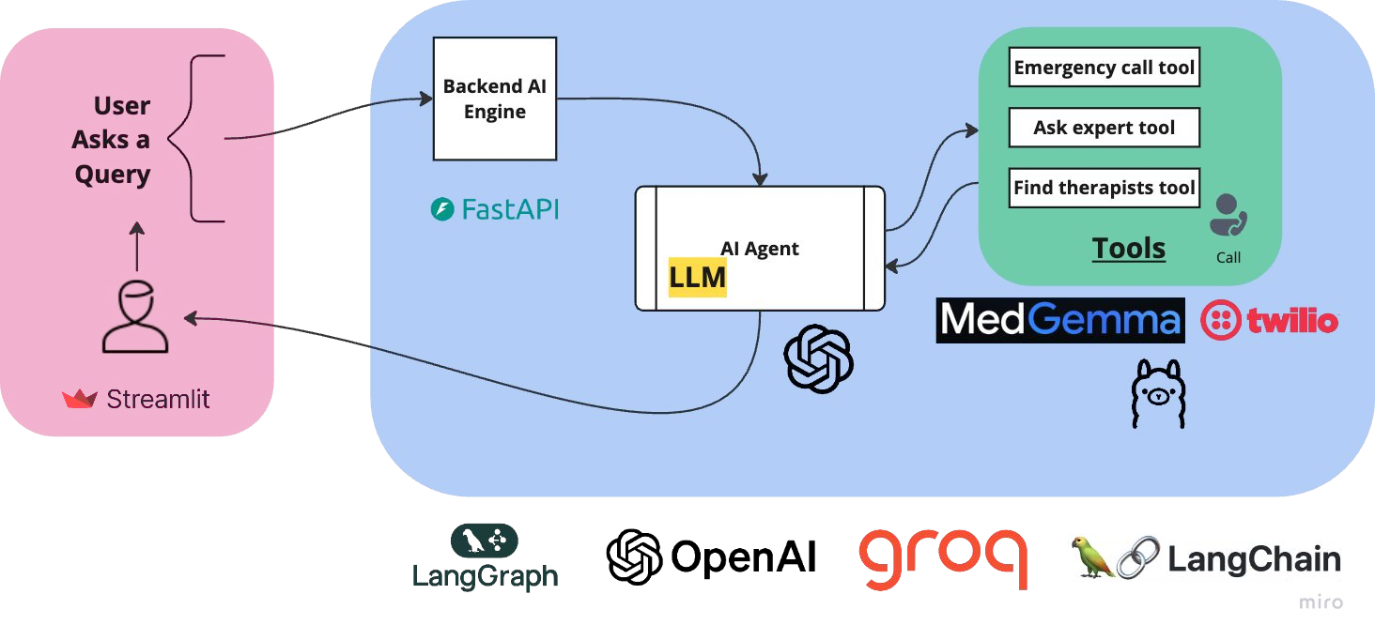
First Stage Architecture

Slide 5
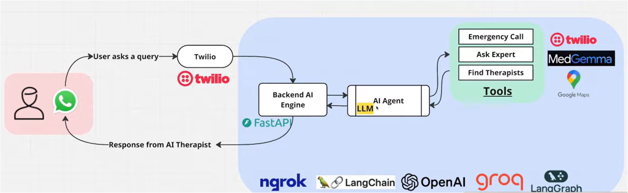
Final Technical Architecture

Slide 6
Code Setup
Phase 1: Setup Frontend
Setup Streamlit
User is able to ask question
Show response from backend
Phase 2: Setup Backend
Setup FastAPI backend
Receive and validate request from Frontend
Send response to the frontend
Phase 3: Setup AI Agent & Tools
Setup Ollama with Medgemma tool
Setup Twilio calling API tool
Setup Location tool
Create an AI Agent & Link to backend
Phase 4: Configure WhatsApp & Twilio
Setup Twilio Sandbox
Setup laptop server using NGROK
Connect Twilio & WhatsApp
Validate WhatsApp → Backend → Response loop
Phase 5: Test Everything Together
Full flow testing
Crisis detection → emergency call
Location search → therapist finder
WhatsApp + Web UI both working

Slide 7
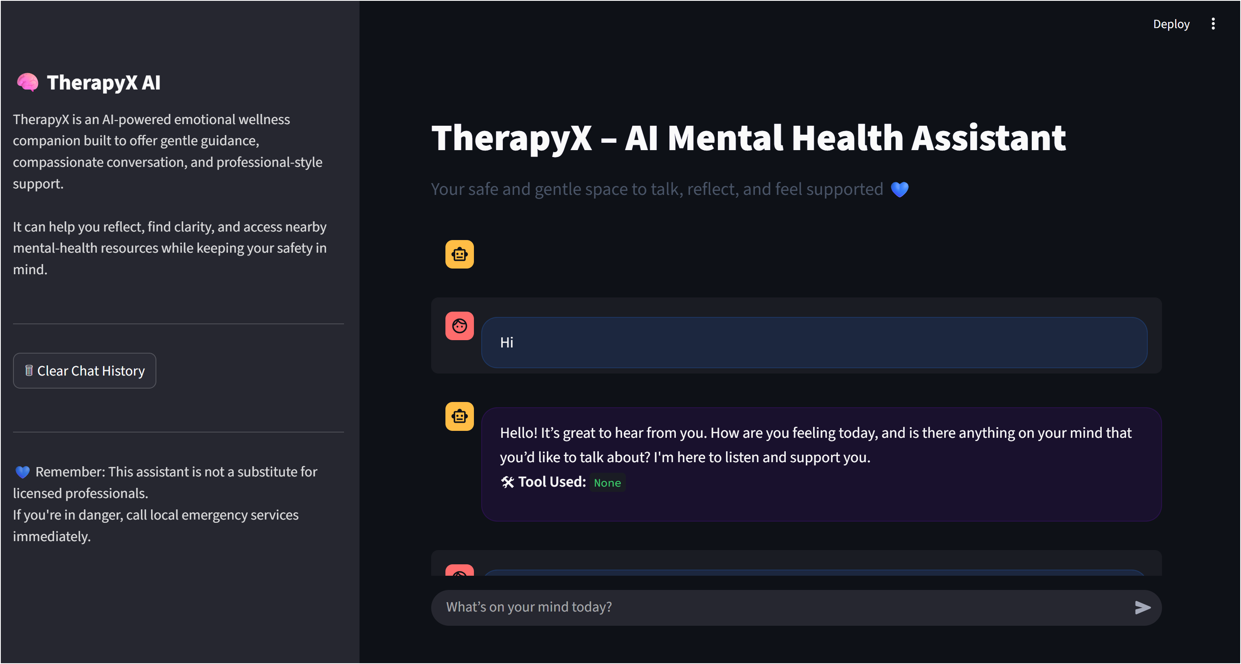
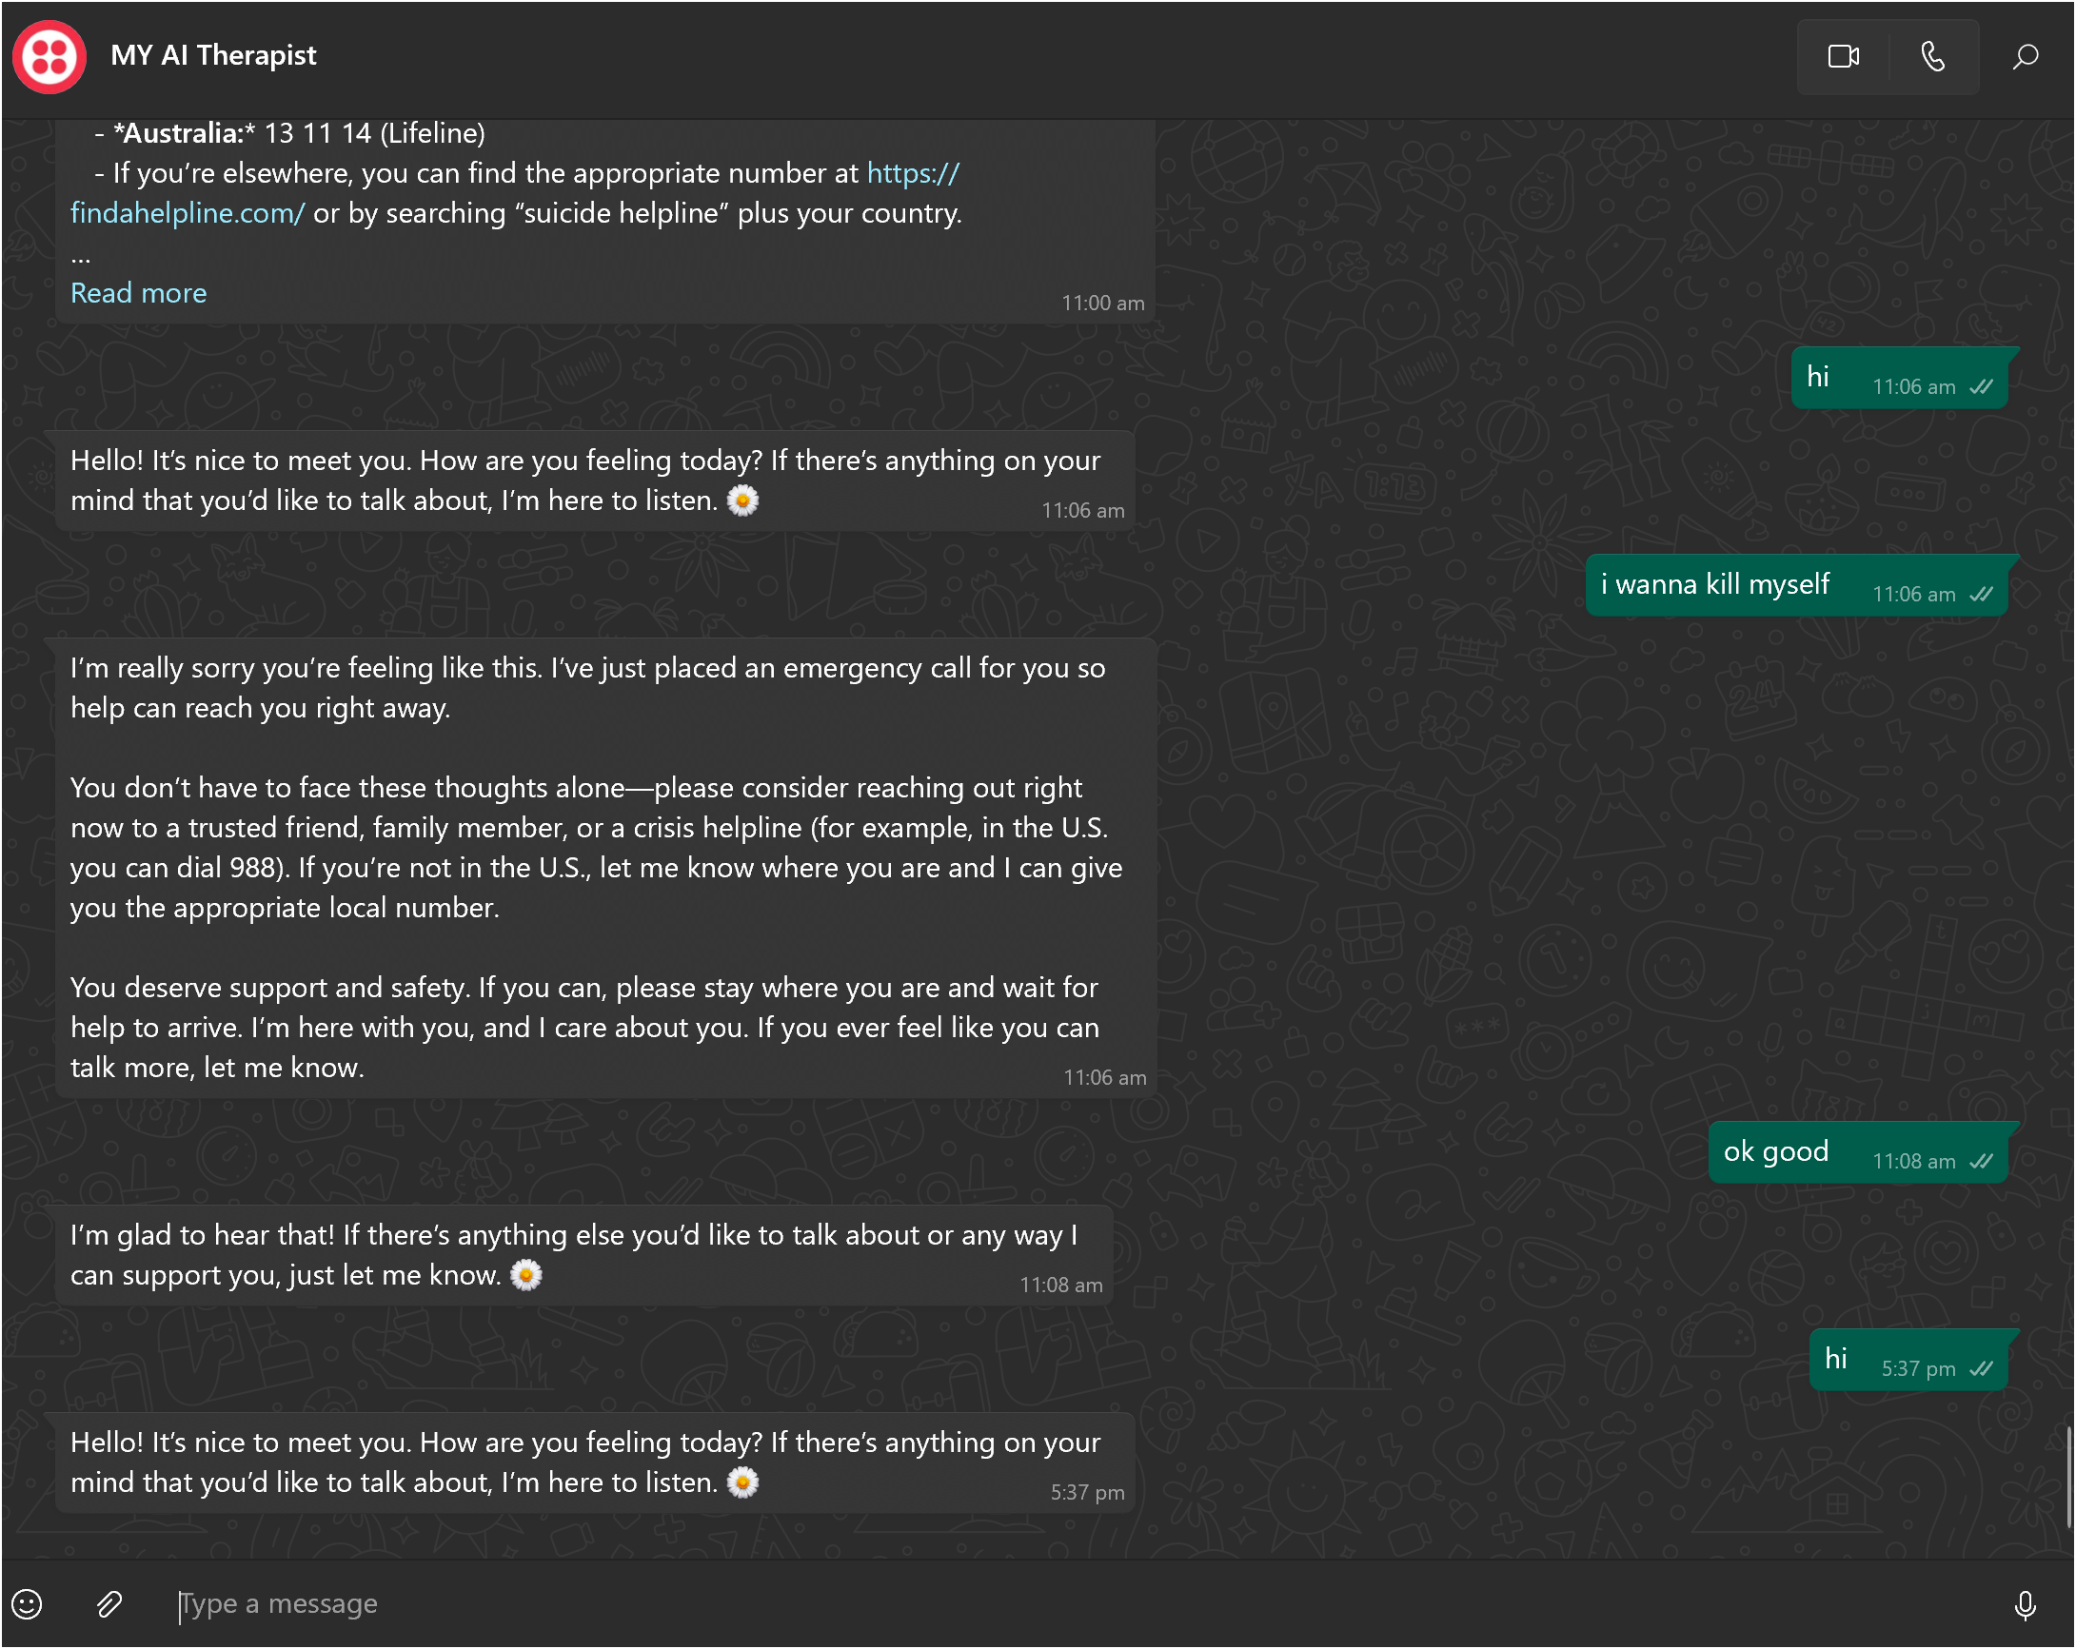
Front-End Displays :
1. Streamlit
2. Whatsapp

